Slide 1
10
End of Year revision
Summer
Translations

Slide 2
End of Year lessons: Translations
Topic | Knowledge |  |  |  | Skills | Exam Skills
 | Vocabulary |  | Grammar | Phonics
Traducimos Lesson on translation skills: spelling and avoiding word-to-word translation. | Key words to be taught: |  | Revisit: Possessive adjectives Key spelling rules for double consonants Grammar structures that differ from English: Adjective agreement and position. Use of prepostion “de” for adjectival phrases. Use of articles when expressing the time, day and when generalising. Omission of English auxiliary verb in negatives and interrogatives. Omission of personal pronoun when the verb is conjugated. Other structures such as: Verb “hacer” to express weather The different Spanish translations of “to get + adjective” “to look + preposition” “to have a good time” “to be + adjective” | Spelling of English “ph” in Spanish (/f/) Spelling of English –tion in Spanish /coin/ HT: How marked accents can change the meaning of words. | Understanding how sounds match letters so that they are less likely to make spelling errors in translations. Understanding sentence structures differences. Apply previous knowledge of grammar and spelling to prevent literal translations that sound unnatural. | Translation skills: reading skills for translations from Spanish to English and writing skills for translation from English to Spanish.
 | orgulloso* | proud
 | piel (f)* | skin, fur, leather
 | acabar de (+ infinitive)* | to have just + pp
 | cuidar* | to look after
 | esperar* | to hope, wait, expect
 | parecer; parecerse a* | to seem
 | pertenecer * | to belong
 | seguir + present participle* | to continue to, still be+ing
 | acción (f) | action
 | entrada (f) | entrance, admission ticket
 | farmacia (f) | pharmacy, chemist's
 | joven (mf) | young person
 | natación (f) | swimming
 | piscina (f) | swimming pool
 | primo (m), prima (f) | cousin
 | publicación (f) | post, publication
 | tener suerte | to be lucky
 | buscar | to look for, search
 | casarse | to get married
 | coger | to take, catch
 | cuidar | To look after
 | llamar; llamarse | to call, phone, to be called
 | montar a caballo | to ride a horse
 | lo paso bien | I have a good time
 | tener cuidado | to look out; to be careful
 | gratuito | free (money)
 | libre | free, vacant
 | porque | because
 | por qué | why
 | si | If
 | sí | yes

Slide 3
Overview of the EoY Revision: Translations
This lesson will focus on the following key points in translations:
Optional Do Now: translating possessive adjectives (FT / HT differentiated)
Improving our spelling in translation
  Theory
  Guided Practice
Avoiding word-to-word translations
  Key structures to watch out for
  Guided Practice
  Guided Practice: Translation from Spanish to English (FT / HT)
Independent Practice:
  Translation from English to Spanish (FT / HT)
Resources Required
HT / FT Independent Practice translation exercise.
Common Misconceptions
In this lesson, students explore key points to keep in mind when translating between Spanish and English. We will focus on common spelling pitfalls, review important grammar structures that do not translate directly, and pay special attention to word order and how the Spanish preposition “de” is used in English adjectival phrases. These are all familiar concepts as they have been taught before – we are just revisiting them with a translation focus.

Slide 4


Traducimos
06 June 2025
1. Use the right possessive adjective for each phrase.
mi
1 | My brother | ___ hermano
2 | His t-shirt | ___ camiseta
3 | Their team | _________ equipo
4 | Your (pl) car | __________ coche
5 | Your best friends | ___ mejores amigos
6 | Her email | ___ correo electrónico
7 | Our boss | __________ jefa
8 | My siblings | _____ hermanos
9 | Their grades | _________ notas
In Spanish, possessive adjectives must agree in number (and gender in “nosotros” and “vosotros”) with the noun they describe.
E.g. mi libro / mis libros.
In English, possessive adjectives do not change: my book / my books.
su
mi – mis
tu – tus
su – sus
nuestro/a – nuestro/as
vuestro/a – vuestros/as
su - sus
su
vuestro
tus
su
nuestra
mis
sus
Challenge
Explain the rule of possessive adjectives in Spanish. Be ready to share it with the class.
Notes:
Independent practice: Do now HT
Students translate the phrases with the right possessive adjective for each phrase.
To support them, all the possessive adjectives are on the slide.
Challenge: explain the rule of possessive adjectives in Spanish. An example answer will show up later on.
Check:
Answers embedded*.

Slide 5
Traducimos
06 June 2025
1. FT Use the right possessive adjective for each sentence.
1 | My brother | mi hermano (mi / mis)
2 | His t-shirt | ___ camiseta (su / sus)
3 | His team | _____ equipo (su / sus)
4 | Your best friend | _____mejor amigo (tu / tus)
5 | Her email | _____ correo electrónico (su / sus)
6 | My siblings | _____ hermanos (mi / mis)
7 | Your grades | _____ notas (tu / tus)
8 | Her cousins | ____ primos (su/ sus)
Grammar recap:
In Spanish, possessive adjectives must agree in number (and gender in “nosotros” and “vosotros”) with the noun they describe.
E.g. mi libro / mis libros.
In English, possessive adjectives do not change: my book / my books.
su
su
tu
su
mis
tus
sus
Challenge
Make different combinations with the possessive adjectives and nouns. E.g. her siblings: sus hermanos.
Notes:
Independent practice: Do now FT
Students choose the right possessive adjective for the phrases in the left column.
Challenge: Students make different combinations with the possessive adjectives and nouns.
Check:
Answers embedded*.

Slide 6

Improving our spellings in translations and avoiding word-to-word translations.

Slide 7
Avoiding common pitfalls in your translations:
Spelling

Slide 8

1.1 Improving our spelling.
Spelling is important when translating, occasional mistakes will not cost you marks, unless they make the meaning unclear.
Use these tips to help you spell better:
  The English ending “-tion” becomes “-ción” in Spanish (-ciones, in plural).
    translation: traducción
    education: educación
    publication: publicación
    intentions: intenciones
    information: información
    apps, applications: aplicaciones
  Sound symbol correspondence: the combination “ph” does not exist in Spanish, instead the sound is always written with the letter “f”.
  photo: foto
  elephant: elefante
  philsofy: filosofía
  alphabet: alfabeto
  physics: física
  HT: Marked accents can change the meaning of a word.
  hablo = I speak but habló= he/she spoke
  I know= sé but se = himself, herself (e.g. se duerme: he falls asleep)
  si= if but sí= yes
  tu: your but tú = you
  el: the but él= the
  mi= my but mí = me
  porque= because but ¿por qué?= why
CaRoLiNa rule: These are the consonants that can be doubled in Spanish.
  c: e.g. acción
  r: e.g. carrera
  l: e.g. lluvia
  n: e.g innovar
Notes:
Explain:
Spelling is a key part of the translation process—misspellings can distort the intended message.
Some spelling mistakes are due to carelessness and are easily avoidable with attention.
Students should be aware of common English-Spanish spelling differences:
-"ph" in English often corresponds to "f" in Spanish (e.g., phone → teléfono).
-"tion" in English is similar to "ción" in Spanish (e.g., nation → nación).
HT students must pay special attention to accent marks in Spanish (they will be assessed on them), as they can change word meanings:
hablo (I speak) vs. habló (he/she spoke)
si (if) vs. sí (yes)
tu (your) vs. tú (you)
mi (my) vs. mí (me)

Slide 9

On Mini Whiteboards:
Write down A or B on your Mini Whiteboards and choose the right translation of the sentence.
Notes:
Check:
Students need to write A and B in each side of the MWB and choose the best translation for the sentences.

Slide 10

Improving your spelling: choose the right translation.
1. His service was excellent.
2. My PE teacher
A
Su servicio fue excelente.
A
Mi professor de education physica.
B
Su servicio fue excellente.
B
Mi profesor de educación física.
3. The tennis club seems interesting.
4. I called the pharmacy yesterday.
A
El club de tenis parece interesante.
A
Yamé a la pharmacia ayer.
B
El club de tennis parece interessante.
B
Llamé a la farmacia ayer.
Notes:
Check:
Each question will appear individually.
Answers are embedded.

Slide 11
On Mini Whiteboards:
HT marked accents
Write down the right word for the translation
Notes:
Check:
Students need to write the right word for the translation: focus on words with marked accents.

Slide 12
HT Write down the right word for the translation
1 If I can, I will go to the party.
____ puedo, iré a la fiesta
2. he sent an email to his boss.
________ un correo a su jefa.
A
Sí
B
Si
A
mando
B
mandó
3. I like what my friend is reading.
A ___ me gusta lo que __ amigo lee.
4. Will you take the bus?
¿___ cogerás ___ autobús?.
A
mi / mí
B
mí / mi
A
tu/él
B
tú / el
Notes:
Check:
Questions will appear individually.
Answers are embedded.*

Slide 13
FT Revisa la traducción
Read this student’s translation and find the 8 spelling errors. You should only write the word spelt correctly in your exercise book.
I love science lessons:
Me encantan las classes de sciencias (2).
2. Physical exercise is necessary for your health:
El ejercicio phisico es necessario para tu salud (2).
3. I have the intention to buy a new phone:
Tengo la intention de comprar un telephono nuevo (2).
4. There is an app to teach your dog to follow rules.
Hay una application para enseñar a tu pero a seguir reglas (2).
Notes:
Independent Practice (FT) :
Students read the translation from English to Spanish and find 8 spelling errors.
Students write down the correct words in their book.

Slide 14
FT Corrige
I love science lessons:
Me encantan las clases de ciencias (2).
2. Physical exercise is necessary for your health:
El ejercicio físico es necesario para tu salud (2).
3. I have the intention to buy a new phone:
Tengo la intención de comprar un teléfono nuevo (2).
4. There is an app to teach your dog to follow rules.
Hay una applicación para enseñar a tu perro a seguir reglas (2).
Notes:
Correct:
Answers embedded on the board.*

Slide 15
HT Revisa la traducción
Read this student’s translation and find 12 spelling errors (including 3 marked accents). You should only write the word spelt correctly in your book.
HT English text:
I love science lessons, especially physics and chemistry, which is why I have the intention to study a Pharmacy degree at university. Out of all options, it is the most interesting one for me.
HT Traducción incorrecta:
Me encantan las classes de sciencias, specialmente phísica y quimica, por eso tengo la intention de studiar la carera de pharmacia en la universidad. De todas las options, es la más interessante para mi.
Notes:
HT Independent Practice:
Students read the translation from English to Spanish and find 12 spelling errors (including 3 marked accents).
Students write down the word spelt correctly in their books

Slide 16
HT Corrige
HT Traducción incorrecta:
Me encantan las classes de sciencias, especialmente physica y química, por eso tengo la intention de studiar la carera de pharmacia en la universidad. De todas las options, es la más interssante para mi.
HT Traducción correcta:
Me encantan las clases de ciencias, especialmente la física y química, por eso tengo la intención de estudiar la carrera de farmacia en la universidad. De todas las opciones, es la más intersante para mí.
Notes:
Correct:
Answers embedded on the board.*

Slide 17
Avoiding “word-for-word” translations

Slide 18
1.2 Avoiding “word-for-word” translation.
When translating to another language, remember that words, verbs and grammar structures often differ. Also, watch out for the word order!
Preposition “de”
A leather jacket: una chaqueta de piel
My cousin’s birthday: el cumpleaños de mi prima
The English teacher: la profesora de inglés
Verb “hacer” to express weather
it is sunny: hace sol
it is cold: hace frío
it is bad weather: hace mal tiempo
Use of articles: el , la, los, las (the)
days of the week: on Sundays = los domingos
time: at 5:00pm = a las cinco de la tarde.
nouns after opinion verbs: I like Spanish= me gusta el español.
generalising: Young people are proud: los jóvenes son orgullosos.
with certain nouns: I go to school: voy al colegio (a + el = al)
Notes:
Explain:
one of the major pitfalls in translating from one language to another is to translate word-for-word as languages often differ.
Focus on three examples:
Preposition “de”: overlook in phrases like la casa de Juan (Juan’s house) or when English uses a noun as an adjective (e.g. Music concert: el concierto de música).
Weather expressions: the use of “hace” to express some weather expressions such as “hace calor: it is hot”.
Articles: English often omits articles where Spanish requires them (e.g. time expressions, days, general nouns, certain expressions).

Slide 19
On Mini Whiteboards:
Choose the right missing part of the translation and write it down on your MWB.
Notes:
Check:
Students need to choose the right missing part of the translation

Slide 20
HT Write down the right word for the translation
1. On Sundays we go horse riding.
________ montamos a caballo.
2. I have just done my Spanish test.
Acabo de hacer ______________
A
Los domingos
B
En los domingos
A
mi prueba de español
B
mi prueba española
3. School starts at 8:30am.
______ empieza ___ ocho y media
4. It is not very hot today.
____________________
A
Colegio / a
B
El colegio / a las
A
No hace mucha calor hoy
B
No es muy caliente hoy
Notes:
Check:
Questions will appear individually.
Answers are embedded.*

Slide 21
HT Write down the right word for the translation
The entry ticket was free for students.
La entrada era gratuita para..
2. Young people’s health should improve.
________________ debería mejorar.
A
estudiantes
B
los estudiantes
A
la salud de los jóvenes
B
personas jóvenes salud
3. I leave work very late
Salgo _____ muy tarde.
4. I like sunbathing when it is sunny.
Me gusta tomar el sol cuando____
A
del trabajo
B
de el trabajo
A
es sol
B
hace sol
Notes:
Check:
Questions will appear individually.
Answers are embedded.*

Slide 22
1.2 Avoiding “word-for-word” translation.
Watch out for negative and interrogative sentences; word order (e.g. adjectives) and translating some English phrasal verbs (e.g. to look after, to look forward, to look at…).
Other phrases:
to look like: mirar parecerse
to look for: mirar para buscar
to look after: mirar atrás cuidar
to have a good time: tener un buen tiempo pasarlo bien
to have breakfast: tener desayuno tomar el desayuno
“tener + noun” = to be + adjective. e.g. to be lucky: tener suerte
lots of: mucho/a/os/ as (without of)
(HT) to just do something: acabar de + infinitive
(HT) to usually do something: soler de + infinitive
Translating the word “get” into Spanish (often turns into reflexive verb).
To get dressed: vestirse (me visto temprano)
to get bored: aburrirse (jugar a las cartas me aburre)
to get married: casarse (Luis se va a casar con Ana)
to get lost: perderse (Me perdí en la ciudad)
Negatives and Interrogatives:
Auxiliary verb is not translated.
I did not go to school = No fui al colegio.
Did you go to school? ¿Fuiste al colegio?
He does not like basketball: no le gusta el baloncesto
Word order:
adjectives: a beautiful town: un pueblo bonito
superlatives: the most beautiful town: el pueblo más bonito
subject pronouns: usually omitted in Spanish. I am tired: estoy cansada
object pronouns: I see him: le veo (before the verb in Spanish)
Notes:
Explain:
In Spanish, auxiliary verbs like do or does aren't used for negatives or questions; instead, verb conjugation and intonation handle these functions.
Word order also differs—adjectives usually follow nouns (casa blanca).
Verbal structures that change: English phrasal verbs often require entirely different structures in Spanish.

Slide 23
Empareja
10. look out!
1. I look for
3. they look into
2. I look after
I have breakfast
6. I am lucky
5. I get bored
8. She was successful
7. we get lost
4. I look forward to
11. he got married
12. I will have a good time
tomo el desayuno
busco
¡ten cuidado!
tengo suerte
investigan
me aburro
cuido
tenía éxito
tengo ganas de
se casó
lo pasaré bien
nos perdemos
Notes:
Independent practice: speaking
In pairs, students find the matching pairs of the verbal expressions on the board. The share their findings orally.
To facilitate the matching, most of the verbs are conjugated so that they can look at conjugation patterns if they cannot remember the word.
All these words have been learnt previously.
Check:
Teachers cold call across the room.
Pairs will show in colours when clicking (use the numbers to ask across the class).

Slide 24

On Mini Whiteboards:
Translation mosaic:
Translate the sentence using only words from the mosaic
Notes:
Check:
Students need to write A and B in each side of the MWB and choose the best option (preterite or imperfect) for each answer.

Slide 25

On Mini Whiteboards: Traduce
I don’t like fast food.
Click to start
30-second timer
No me gusta la comida rápida.
me | gusta | gustan
rápida | rápido | comida
la | yo | no
Your time is up!
Notes:
Check:
Students translate the sentence into Spanish using only the words from the mosaic.

Slide 26
On Mini Whiteboards: Traduce
Today it is very hot.
Click to start
30-second timer
Hoy hace mucha calor.
es | calor | caliente
hace | mucha | hoy
mucho | ayer | muy
Your time is up!
Notes:
Check:
Students translate the sentence into Spanish using only the words from the mosaic.

Slide 27
On Mini Whiteboards: Traduce
The entrance to the theatre is free
Click to start
30-second timer
La entrada al teatro es gratuita.
a + el
free of charge (related to money)
libre: vacant, free (lack of restriction)
es | entrada | libre
gratuita | la | al
a | el | teatro
Your time is up!
Notes:
Check:
Students translate the sentence into Spanish using only the words from the mosaic.

Slide 28
On Mini Whiteboards: Traduce
He did not get married last summer.
Click to start
30-second timer
Él no se casó el verano pasado
HT: pronoun “he” instead of article “the” (el)
se | el | verano
él | no | pasado
hizo | conseguir | casó
Your time is up!
Notes:
Check:
Students translate the sentence into Spanish using only the words from the mosaic.
Opportunity for teacher to remind students of the difference between él (pronoun) vs el (article).

Slide 29
On Mini Whiteboards: Traduce
On Saturday we celebrate my boyfriend’s birthday.
Click to start
30-second timer
El sábado celebramos el cumpleaños
de mi novio.
celebramos | mi | novio
sábado | en | el
el | de | cumpleaños
Your time is up!
Notes:
Check:
Students translate the sentence into Spanish using only the words from the mosaic.

Slide 30
On Mini Whiteboards: Traduce
My dad is the proudest in the family.
Click to start
30-second timer
Mi padre es el más orgulloso de la familia.
el | familia | de
padre | mi | orgulloso
es | más | la
Your time is up!
Notes:
Check:
Students translate the sentence into Spanish using only the words from the mosaic.

Slide 31
On Mini Whiteboards: Traduce
I am going to have fun at the graduation party.
Click to start
30-second timer
Voy a pasarlo bien en la fiesta de graduación.
pasarlo | fiesta | la | tener
diversión | voy | a | soy
bien | en | graduación | de
Your time is up!
Notes:
Check:
Students translate the sentence into Spanish using only the words from the mosaic.

Slide 32
On Mini Whiteboards: Traduce
Estoy buscando mis deberes de ciencias.
Click to start
30-second timer
I am looking for my Science homework.
I | looking | homework
am | for | science
after | up | of
Your time is up!
Notes:
Check:
Students translate the sentence into English using only the words from the mosaic.

Slide 33
On Mini Whiteboards: Traduce
Cuido de mi salud todos los días
Click to start
30-second timer
I look after my health every day.
I | health | look
my | forward to | every
after | the | day
Your time is up!
Notes:
Check:
Students translate the sentence into English using only the words from the mosaic.

Slide 34
On Mini Whiteboards: Traduce
My cousin is 24 and is a policeman.
Click to start
30-second timer
Mi primo tiene veinticuatro años y es policía.
tiene | veinticuatro | es | policia hombre
primo | policía | años | una
mí | un | mi | y
Your time is up!
Notes:
Check:
Students translate the sentence into Spanish using only the words from the mosaic.

Slide 35
On Mini Whiteboards: Traduce
Mis profesores me ayudan cuando pueden.
Click to start
30-second timer
My teachers help me when they can.
teachers | when | they | me
help | can | my | I
Your time is up!
Notes:
Check:
Students translate the sentence into English using only the words from the mosaic.

Slide 36
On Mini Whiteboards: Traduce
(HT) Acabo de comprar unos pantalones de piel.
Click to start
30-second timer
I have just bought some leather trousers.
I have | trousers | some
to buy | of | leather
bought | Just | I finish
Your time is up!
Notes:
Check:
Students translate the sentence into English using only the words from the mosaic.

Slide 37

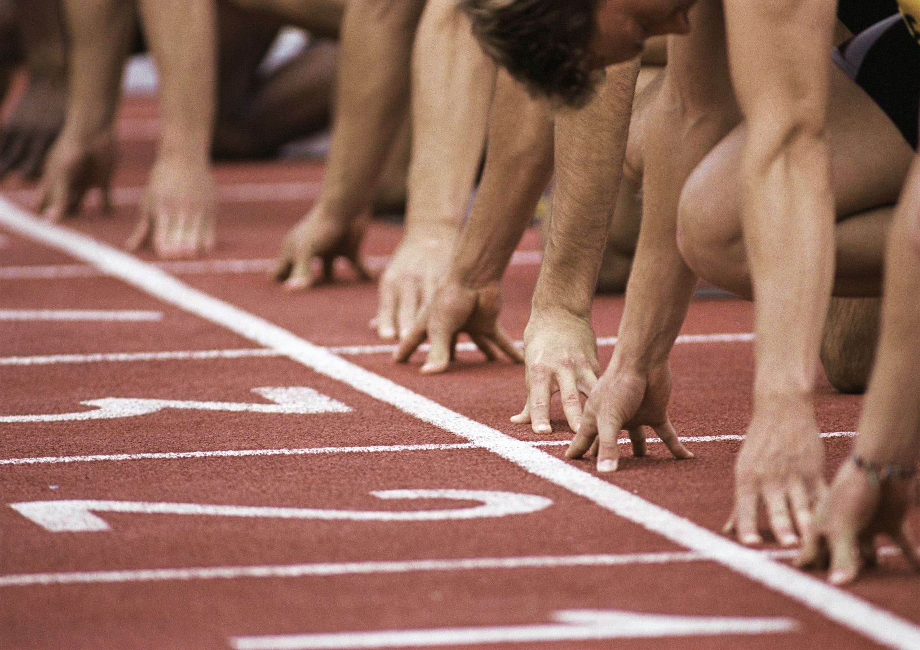



Translation Relay!
Work in pairs to translate the sentences on the board.
One person translates for 30 seconds, then swap (check the timer!)
While one translates, the other can look up vocabulary and help.
The winning pair is the one that finishes all translations accurately.
Only one pen can be seen on your tables!
If stuck, skip the word, draw a line and come back to it later—but remember don’t miss key information! You could use a synonym to convey the same message.
Ganadores
30s
Notes:
Independent Practice:
Teachers organise students into pairs.
They instruct each pair to share one pen. One student translates for 30 seconds, then they swap roles.
Teachers remind students that while one is translating, the other can support by checking vocabulary or offering help.
The winner pair will be the one that completes all translations accurately and collaboratively.
Teachers can run the activity up to 4-5 minutes.
Alternatively, teachers might choose to use a dice. Students will switch roles when one of them rolls a six.
Check:
Pair assessment with another pair comparing the answers on the board with the pair’s translation.

Slide 38
FT Translation Relay!
In pairs, one person translates for 30 seconds, then swap (check the timer!)
Click to start
30-second timer
En mi tiempo libre practico la natación.
Lo hago dos veces por semana en la piscina local.
Pero a mis amigas no les gusta el deporte.
El mes pasado participé en una competición y gané.
Fue una experiencia maravillosa.
Este verano mis amigas y yo queremos aprender a montar a caballo.
Pienso que lo vamos a pasar muy bien.
Your time is up!
Notes:
FT Independent Practice:
Teachers organise students into pairs.
They instruct each pair to share one pen. One student translates for 30 seconds, then they swap roles.
Teachers remind students that while one is translating, the other can support by checking vocabulary or offering help.
The winner pair will be the one that completes all translations accurately and collaboratively.
Teachers can run the activity up to 4-5 minutes.

Slide 39
FT Peer assessment:
swap your translation with another pair of students.
En mi tiempo libre practico la natación.
Lo hago los jueves en la piscina local.
Pero a mis amigas no les gusta el deporte.
El mes pasado participé en una competición y gané.
Fue una experiencia maravillosa.
En verano mis amigas y yo queremos aprender a montar a caballo.
Pienso que lo vamos a pasar muy bien.
In my free time I practise / do swimming.
Ganadores
I do it on Thursdays at the local swimming pool.
But my friends do not like sports (in general).
Last month I participated in a competition and I won.
It was a wonderful experience.
This summer my friends and I want to learn to ride horses .
I think that we are going to have good time.
Notes:
Check:
Peer assessment: thorough assessment by swapping the translation with another pair.
Number of mistakes to be counted.
The winning pair could be the one that completes the most translations with the fewest mistakes.
Alternatively, the focus could be on identifying and avoiding the types of mistakes we covered in today’s lesson.

Slide 40
HT Translation Relay!
In pairs, one person translates for 30 seconds, then swap (check the timer!)
Mi deporte favorito es el baloncesto, lo hago los martes.
Pertenezco al equipo de mi instituto desde hace dos años.
Acabamos de participar en una competición nacional y la hemos ganado.
4. Este verano tengo ganas de mantenerme en forma durante las vacaciones.
5. Por eso seguiré jugando, si no hace mucha calor.
6. Creo que nunca me aburriré de este deporte.
Click to start
30-second timer
Your time is up!
Notes:
HT Independent Practice:
Teachers organise students into pairs.
They instruct each pair to share one pen. One student translates for 30 seconds, then they swap roles.
Teachers remind students that while one is translating, the other can support by checking vocabulary or offering help.
The winner pair will be the one that completes all translations accurately and collaboratively.
Teachers can run the activity up to 4-5 minutes.
.

Slide 41
HT Peer assessment:
swap your translations with another pair!
Mi deporte favorito es el baloncesto, lo hago los martes.
Pertenezco al equipo de mi instituto desde hace dos años.
Acabamos de participar en una competición nacional y la hemos ganado.
4. Este verano tengo ganas de mantenerme en forma durante las vacaciones.
5. Por eso seguiré jugando, si no hace mucha calor.
5. Creo que nunca me aburriré de este deporte.
My favourite sport is basketball, I do it on Tuesdays.
I have belonged/ I have been a member of/ to my school’s team for two years.
We just participated / took part ina national competition and we won it/ have won it.
This summer I look forward to stay in shape during the holidays.
That is why I will keep playing, if it is not too/very hot.
I think I will never get bored of this sport.
Notes:
Check:
Peer assessment: thorough assessment by swapping the translation with another pair.
Number of mistakes to be counted.
The winning pair could be the one that completes the most translations with the fewest mistakes.
Alternatively, the focus could be on identifying and avoiding the types of mistakes we covered in today’s lesson.

Slide 42
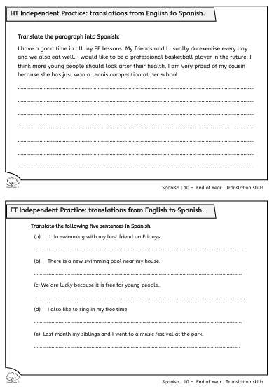
Independent Practice:
HT and FT translations from English to Spanish

Slide 43
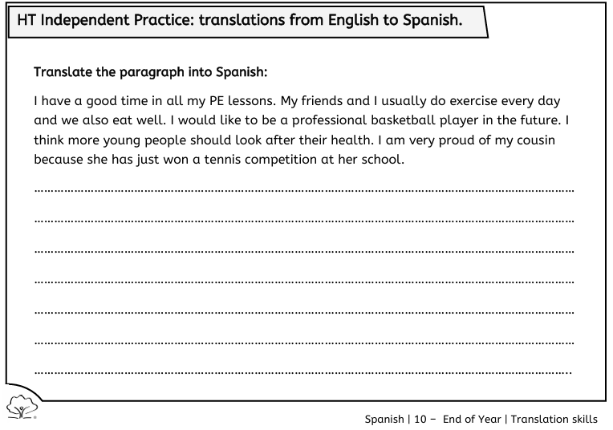

HT Translations: Independent Practice
Translations tips
Before translating: read the whole text first; underline all tricky words; identify the different time frames.
During the translation: avoid word-to-word translation; pay attention to word order; include accent marks.
Notes:
HT Independent Practice:
Students translate the paragraph into Spanish.
Before that, teacher can remind student of the translations tips seen until now (see information box).
Students should do this independently without help.
Check:
Answers will appear in the next slide with comments on how to avoid “word-for-word” translations.

Slide 44

HT Translations: Corrige
I have a good time in all my PE lessons.
Me lo paso bien en todas mis clases de educación física.
no word-by-word
translation
use of “de” + attention to spelling “-ción” /”fí”
My friends and I usually do exercise every day and we also eat well.
Mis amigos y yo solemos hacer ejercicio todos los días y también comemos bien.
no word-by-word
translation
it needs article
“nosotros” omitted but it is fine to have it
I would like to be a professional basketball player in the future.
Me gustaría ser un jugador de baloncesto profesional en el futuro.
use of “de”
“una jugadora de..” is also correct
“un jugador profesional de baloncesto” also correct
accent marks ´
Notes:
Check:
Answers are explained sentence by sentence.*
Opportunity for teachers to ask for the translation skills that have been learnt through the lesson.
Once students these questions are asked, then teacher can click for the explanation to appear.

Slide 45
HT Translations: Corrige
I think more young people should look after their health.
Pienso que más jóvenes deberían cuidar de su salud.
“Creo que” correct
to look after: cuidar
I am very proud of my cousin because .
Estoy muy orgulloso de mi primo porque...
puesto que / ya que..
orgullosa is correct
prima is correct
she has just won a tennis competition at her school.
acaba de ganar una competición de tenis en su colegio.
instituto
escuela
different tense to English
use of “de”
accent marks ´
Notes:
Check:
Answers are explained sentence by sentence.*
Opportunity for teachers to ask for the translation skills that have been learnt through the lesson.
Once students these questions are asked, then teacher can click for the explanation to appear.

Slide 46
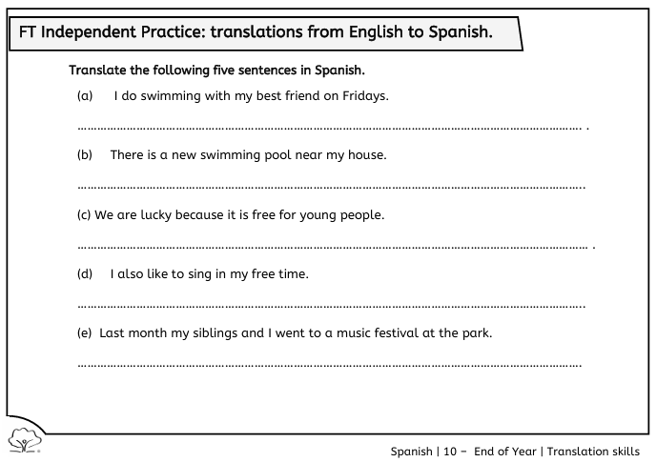
FT Translations: Independent Practice
Translations tips
Before translating:
Read the 5 sentences first.
Underline all tricky words.
  Identify the different tenses.
During the translation:
Pay attention to adjective – noun agreement and adjective position.
Avoid word-to-word translation.
Watch out for articles “el, la, los, las” and preposition “de”.
Notes:
FT Independent Practice:
Students translate five sentrences into Spanish.
Before that, teacher can remind students about the translation's tips seen until now (see information box).
Students should do this independently without help.
Check:
Answers will appear in the next slide with comments on how to avoid “word-for-word” translations.

Slide 47
FT Translations: Corrige
1. I do swimming with my best friend on Fridays.
Hago natación con mi mejor amigo/a los viernes.
nado
practico natación
use of article instead of “on”
2. There is a new swimming pool near my house.
Hay una piscina nueva cerca de mi casa.
adjective position and agreement
3. We are lucky because it is free for young people.
Tenemos suerte porque es gratuito para los jóvenes.
avoid word-to-word translation
article “los” needed: generalising
“people” doesn’t need to be translated
Notes:
Check:
Answers are explained sentence by sentence.*
Opportunity for teachers to ask for the translation skills that have been learnt through the lesson.
Once students these questions are asked, then teacher can click for the explanation to appear.

Slide 48
FT Translations: Corrige
4. I also like to sing in my free time.
También me gusta cantar en mi tiempo libre.
another translation of “free” (“gratuito” is related to money)
5. Last month my siblings and I went to a music festival at the park.
El mes pasado mis hermanos y yo fuimos a un festival de música en el parque.
adjective position and agreement
Article “el” needed
“we went to”
no “I went to”
preposition “de” needed
Notes:
Check:
Answers are explained sentence by sentence.*
Opportunity for teachers to ask for the translation skills that have been learnt through the lesson.
Once students these questions are asked, then teacher can click for the explanation to appear.

